Slide 1

Multi-Agent Exploration and Search with Deep Reinforcement Learning Student Research Project 2018
Tutor: Hadi Samer Jomaa
Team:
Benjamin Hogstad
Krithika Murugesan
Ramya Raghuraman
Michael Ruchte
Mohana Nyamanahalli Venkatesha

Slide 2
Contents
Introduction
Problem Setting
Visualization and Simulator:
State of the Art
Deep Q Learning implementation
Actor critic implementation
Experimental Findings:
A3C
Tangible Outcomes
Work Plan
References

Slide 3
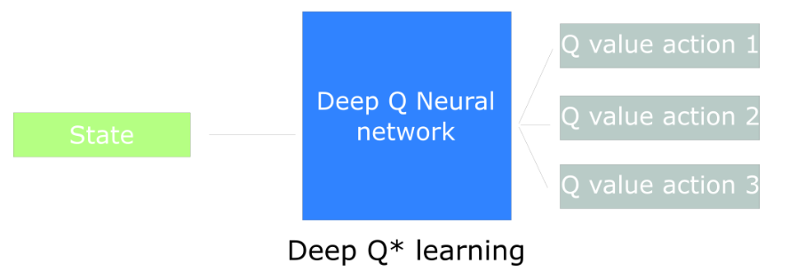
Introduction
Deep Learning : Deep Learning is automating extraction of high level features from data
Deep reinforcement learning : is a machine learning method that extends reinforcement learning approach to learning of the entire process from sensors to motors (end-to-end) using deep learning techniques.
Deep Q-Learning

Slide 4
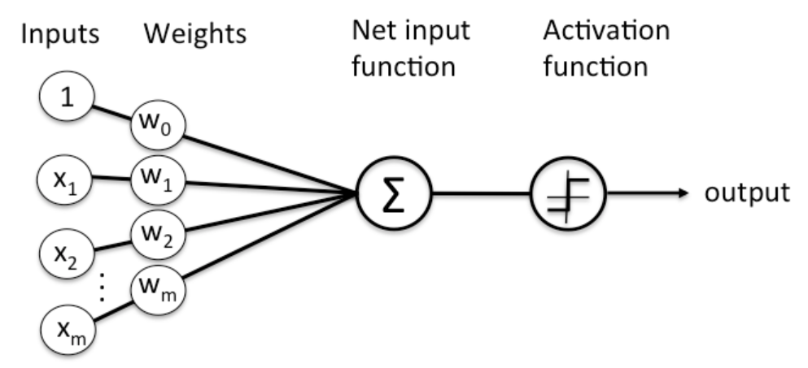
Deep Neural Networks
networks of interconnected layers of algorithms, called neurons
that feed data into each other, and which can be trained to carry out specific tasks by modifying the importance attributed to input data as it passes between the layers.

Slide 5
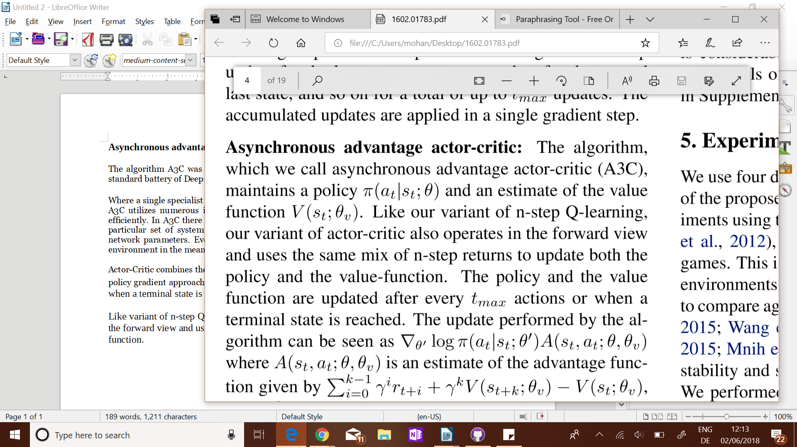

Asynchronous Advantage Actor-Critic
Algorithm A3C was faster, simpler, more robust, and able to achieve much better scores on the standard battery of Deep RL tasks[7].
Actor-Critic combines the benefits of value-iteration method Q-Learning and policy-iteration policy gradient approaches.
Feedforward Networks: Feedfoward neural networks are primarily used for supervised learning in cases where the data to be learned is neither sequential nor time-dependent
Open AI Gym : Open AI Gym to give us more control about what the agent sees.

Slide 6
Problem Setting
autonomous drones (multi-agent) to explore an unknown environment while avoiding obstacles as well as other drones as efficiently as possible in order to find a given target.
Deep Learning for multi-agent systems can be broken into four parts:
Network Structure,
Update Technique,
Action-selection technique,
reward function
The primary focus right now is incorporating Asynchronous Advantage Actor – Critic (A3C)
Aim is to implement for multi drones.

Slide 7
Problem Faced:

Slide 8
important part of the algorithm
State
Action
Reward
Assumptions:
Search area is limited beforehand by the operator
Target is easy to identify – if a drone “sees” the target location, it automatically discovers it
Exploration is time-critical
All drones are able to communicate to all other drones at all times
Drones are able to fly stable in the given direction
Out of scope:
Technical details about drone hardware and communication
Optimization with regard to most efficient use of hardware resources

Slide 9
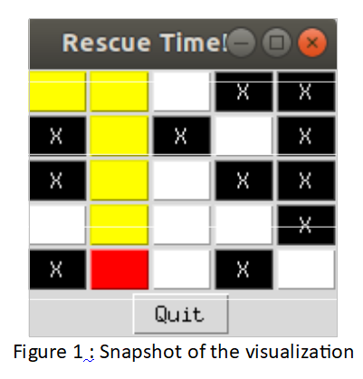
2. Visualization and Simulator:
Each cell in the grid can be an empty space or an obstacle that has to be avoided, the drones should navigate to reach a cell in the grid where the target is positioned.
surrounding to be a 2D grid.
The visualization block uses Tkinter python package
The obstacles are represented as black color, the path traversed by the drone in yellow and the empty spaces in white.

Slide 10
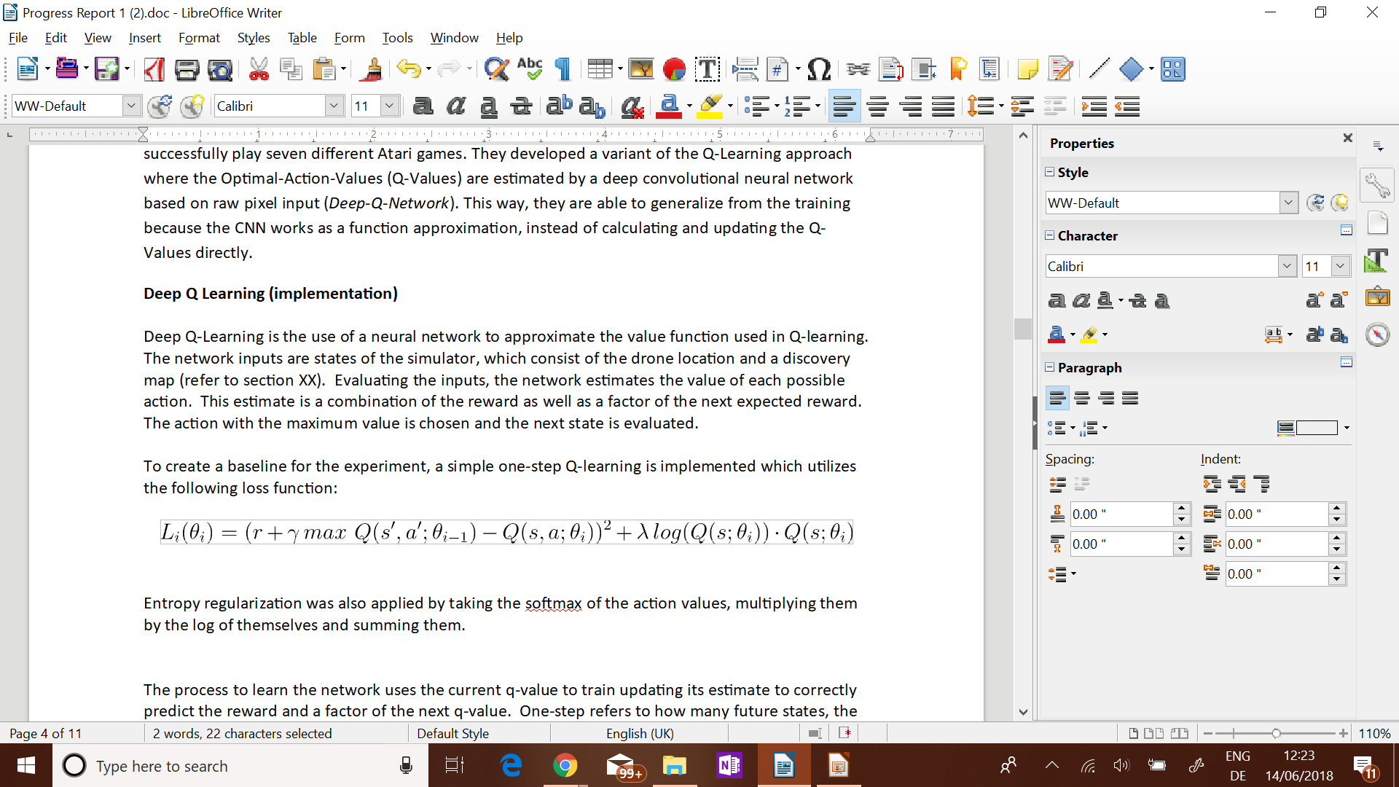
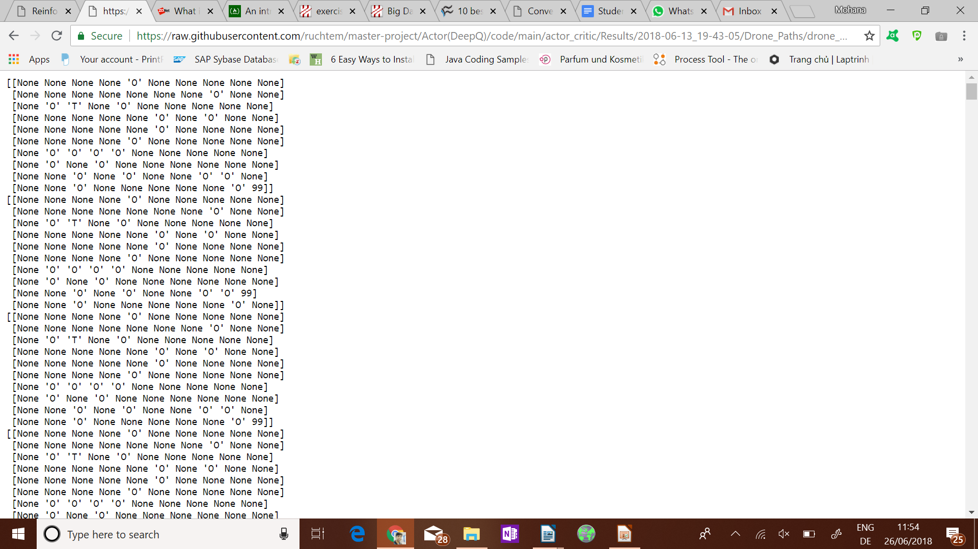
3. State of the Art
Deep Q Learning implementation:
The network inputs are states of the simulator, which consist of the drone location and a discovery map.
a one-step Q-learning loss function:
The Results of one-step Deep Q-network:
Drone Path

Slide 11
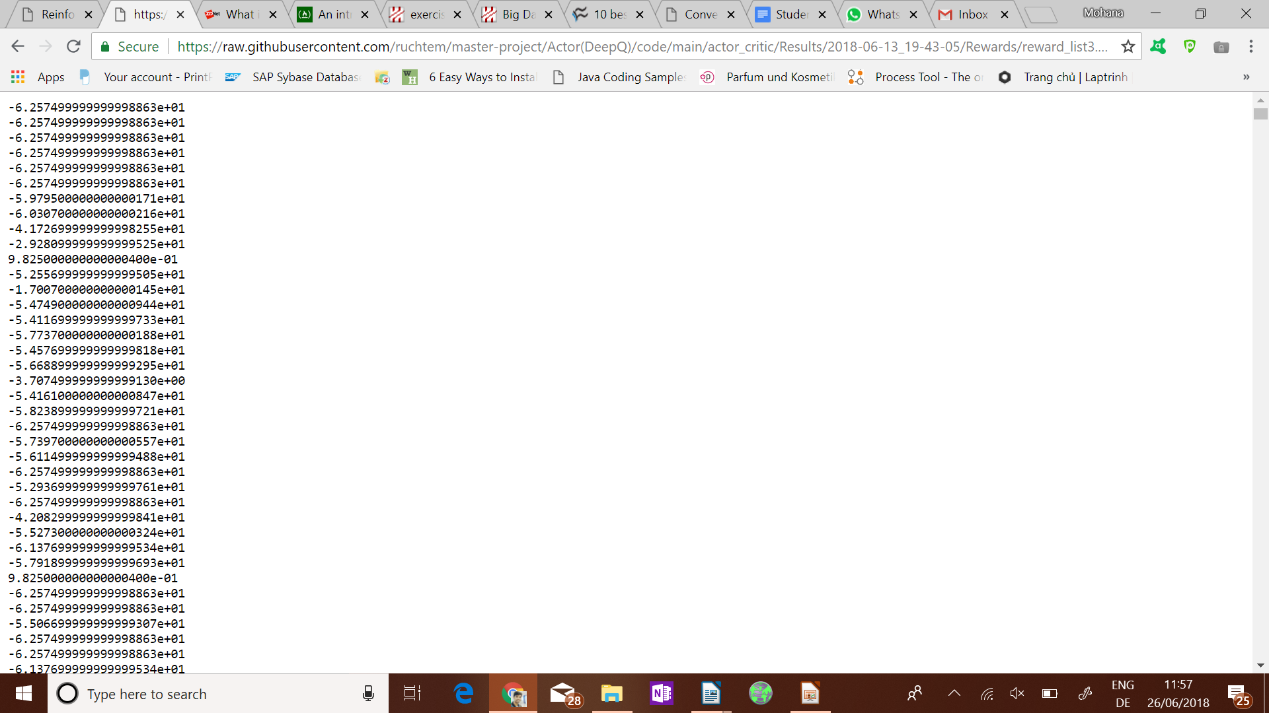
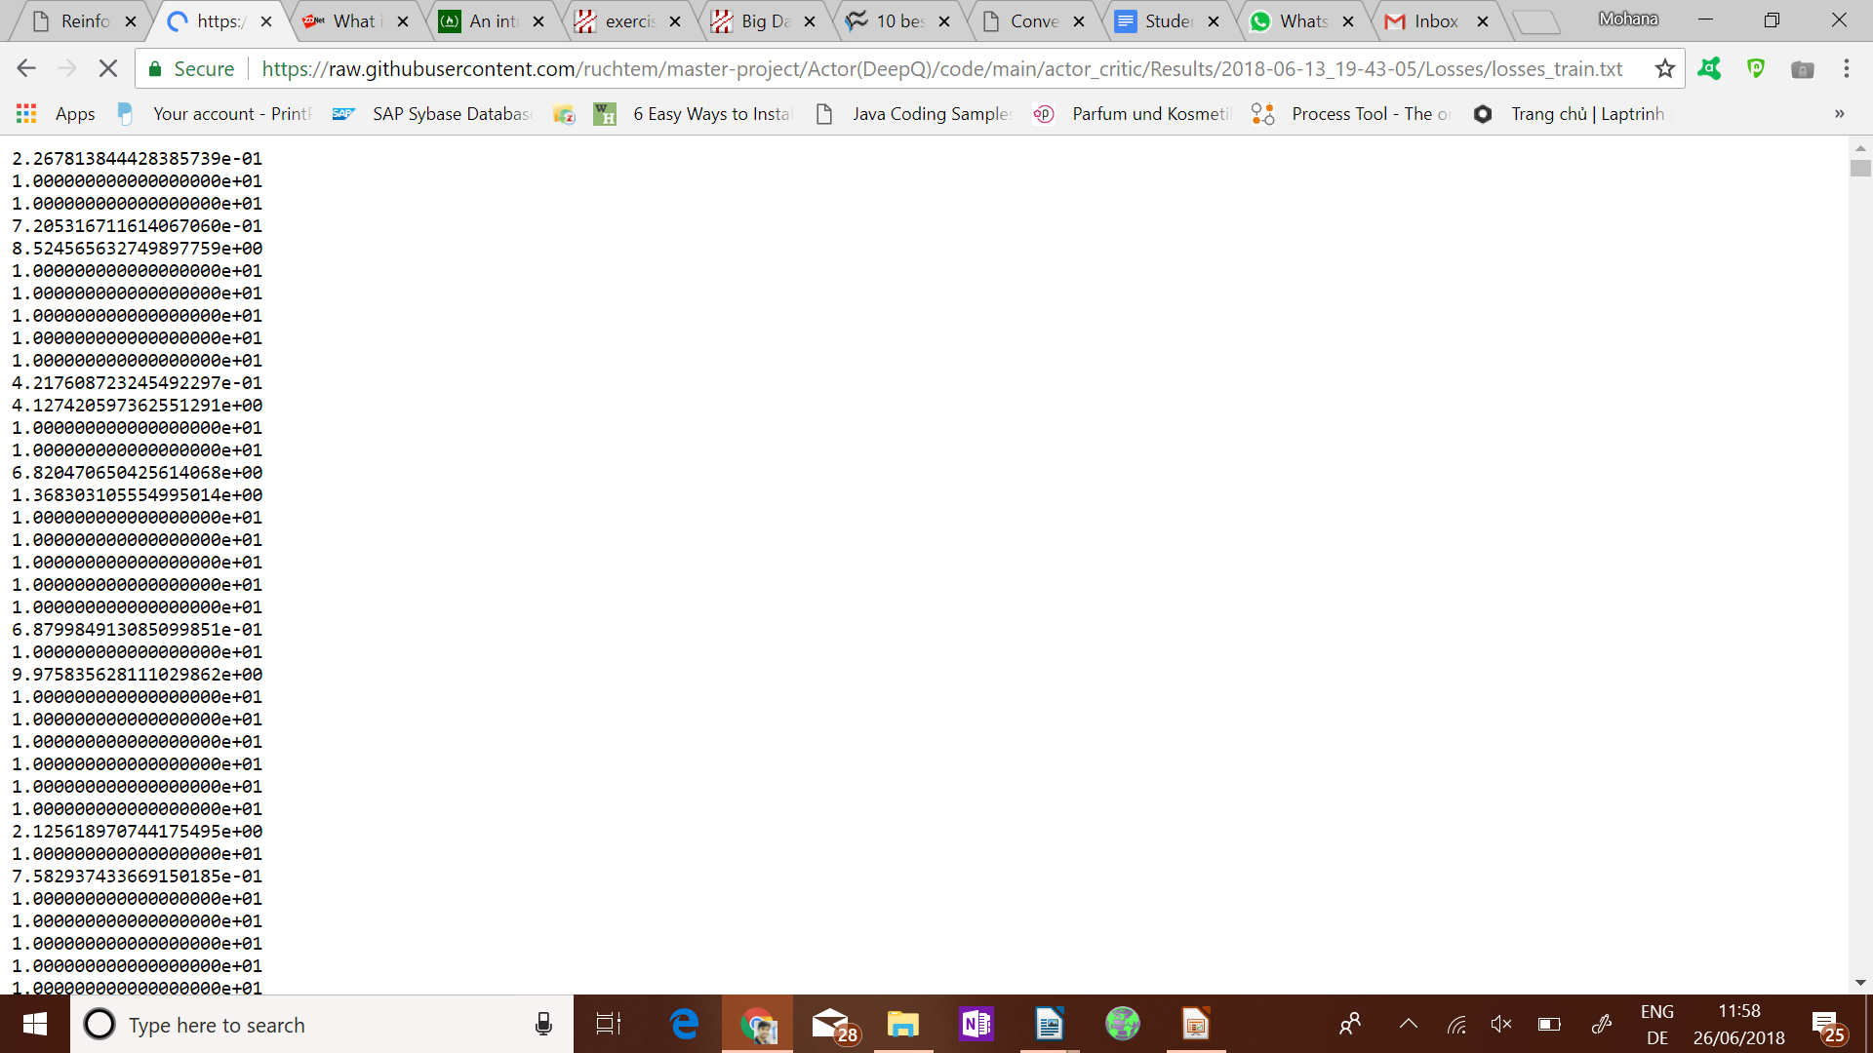
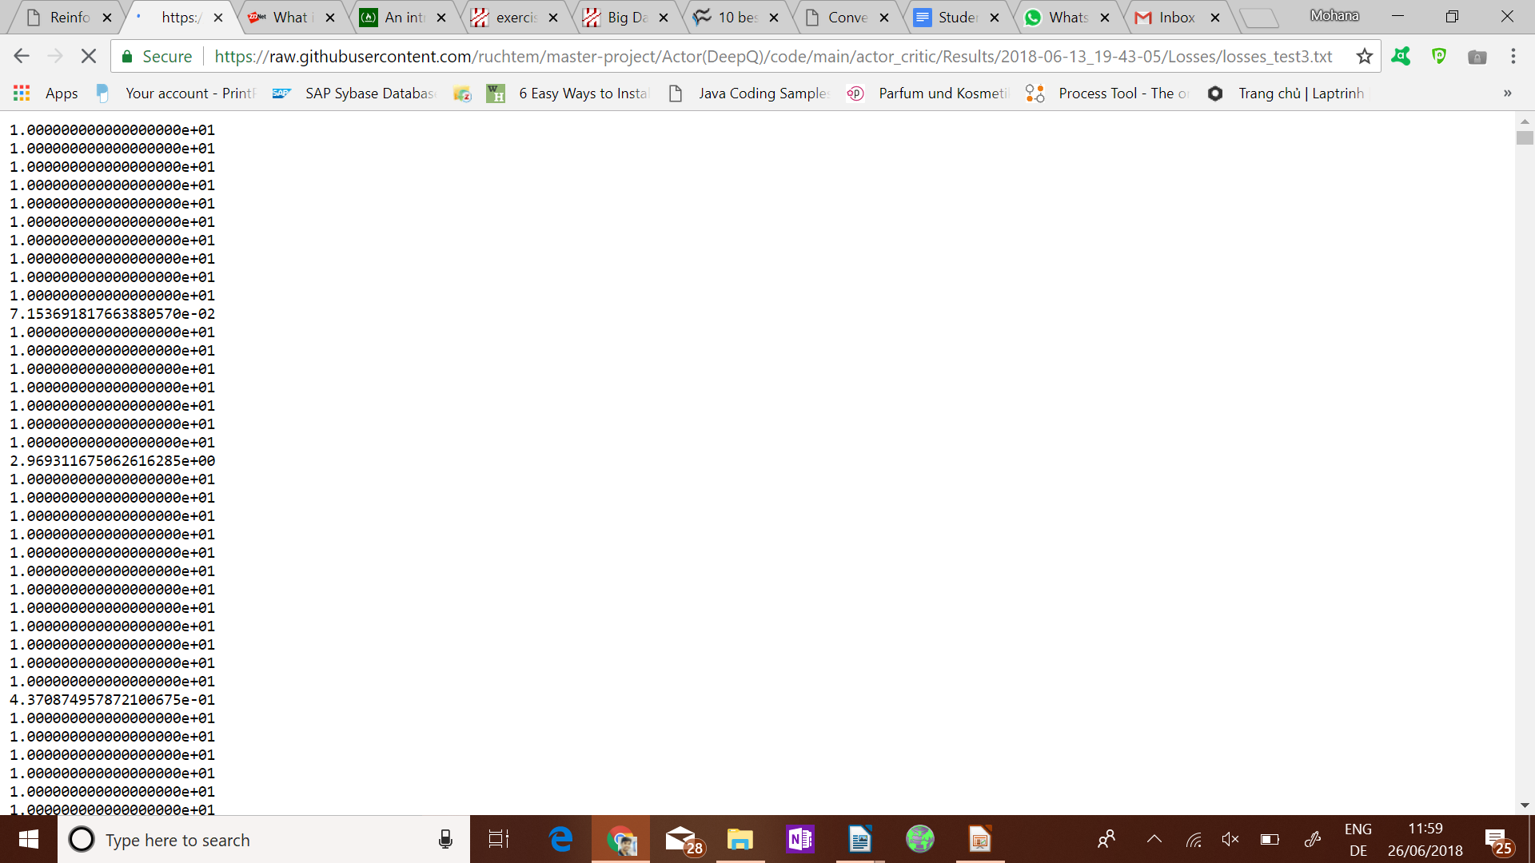


Rewards
Losses train
Losses test
Iteration train
Iteration test

Slide 12
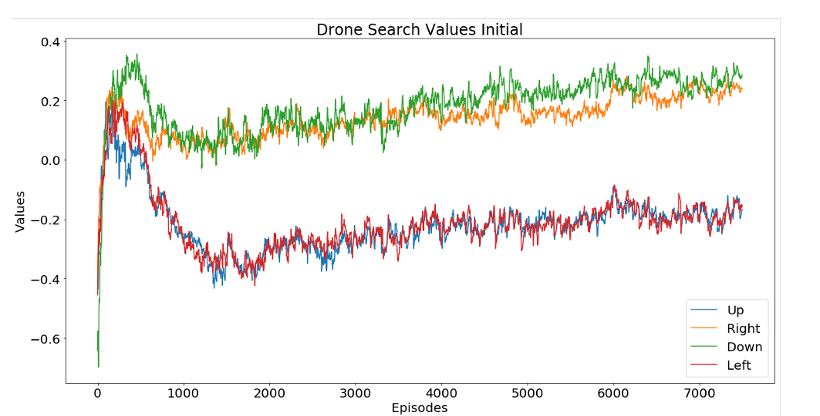
To encourage exploration, a simple E-greedy strategy was deployed.

Slide 13
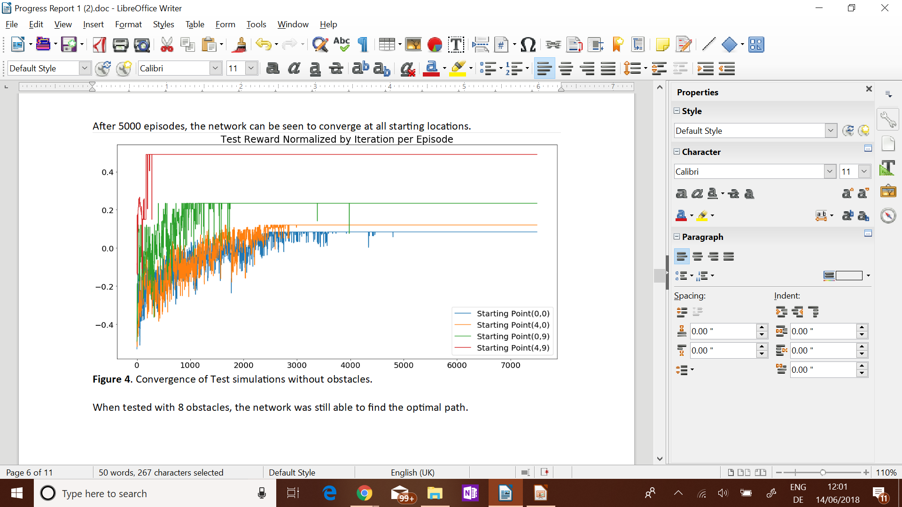

Slide 14
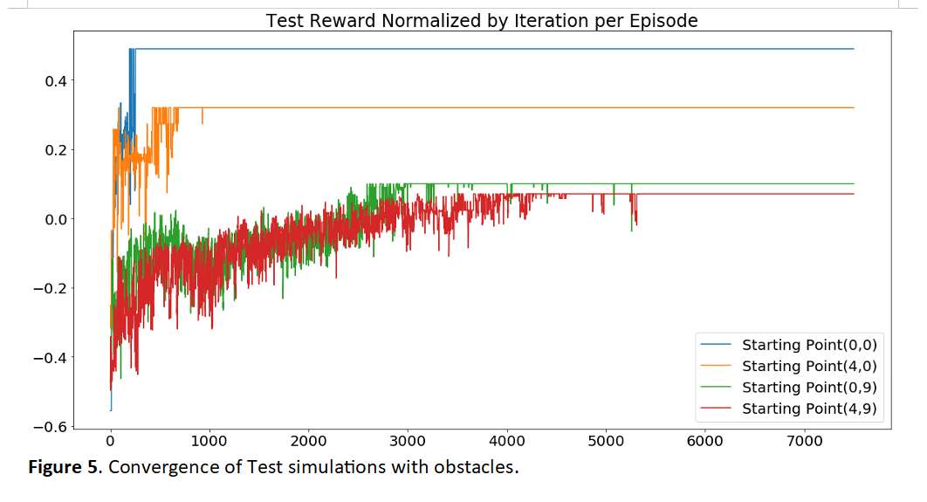

Slide 15
Actor critic implementation
we have one hidden layer and one output layer, where the softmax of 4 nodes represents the policy and the fifth node represents the critic output.
All layers are fully connected layers with relu activation function.
Hidden layer:
100 Input nodes (the features delivered by the simulator)
30 Output nodes. This has been chosen arbitrarily
Policy output layer
30 Input nodes
4 Output nodes
Critic output layer
30 Inputs
4 Outputs

Slide 16
Experimental Results

Slide 17
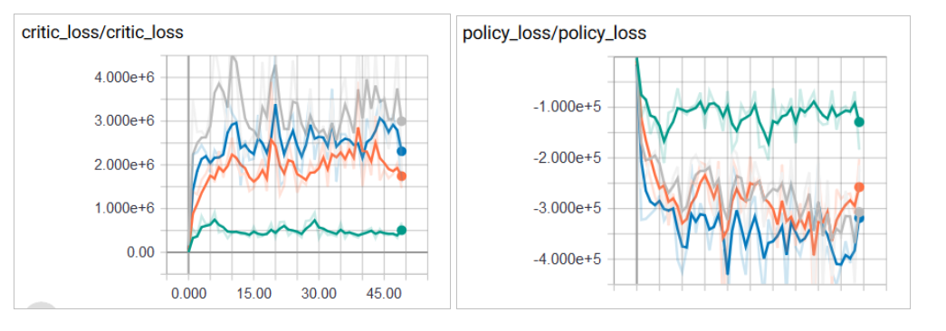
Currently, the policy loss and the critic loss are minimized independently
In tensorboard it can be seen, that these losses are contradicting each other

Slide 18
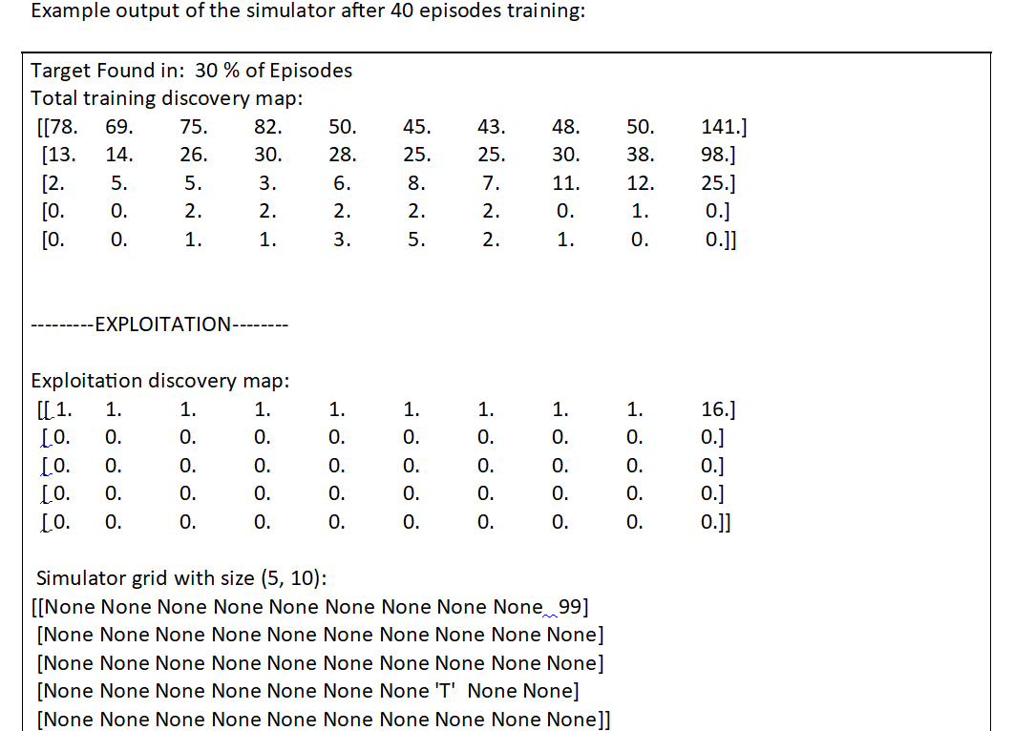
Experimental Findings:

Slide 19
Asynchronous Actor-Critic
[7]advantage actor-critic (A3C)
Used multiple CPU threads on same machine
Each actor-learner calculates its update gradient and sends to a master worker
global network is then distributed out to all actor-learners.
replay memory

Slide 20
Update Technique
we did not implement anything regarding the papers in the proposal. But we still consider Lenient DQN as the optimal way to tackle the problem of correlated states in a multi agent scenario.
Action-selection Technique
For now we are only using e-greedy for the simple implementations. We regard noisy[2] net as the most advanced action selection technique.
Reward/Cost
Reward function uses for the localization task a reward function as simple as just counting the number of robots who have already found the target combined with an action punishment to introduce some efficiency[3].

Slide 21
Tangible Outcomes
A paper will be written to summarize the experiment and key research findings for the purpose of submitting for publication.
In addition to this, we will also be including a demo or a tutorial in the form a video representation.
The video will depict the simulation of the drone navigating through a unknown path in search of the target, while avoiding obstacles on the way.

Slide 22


Slide 23
References
[1] Foerster (2017) Stabilising Experience Replay for Deep Multi-Agent Reinforcement Learning
[2] Fortunato (2018) Noisy Network fo Exploration
[3] Hüttenrauch et al (2017) Guided Deep reinforcement learning for Swarm systems
[4] Mnih et al. (2013) Playing Atari with Deep Reinforcement Learning
[5] Palmer (2018) Lenient Multi-Agent Deep Reinforcement Learning
[6] Zhang (2017) A Deeper Look at Experience Replay
[7] Mnih (2016) Asynchronous Methods for Deep Reinforcement Learning

Slide 24
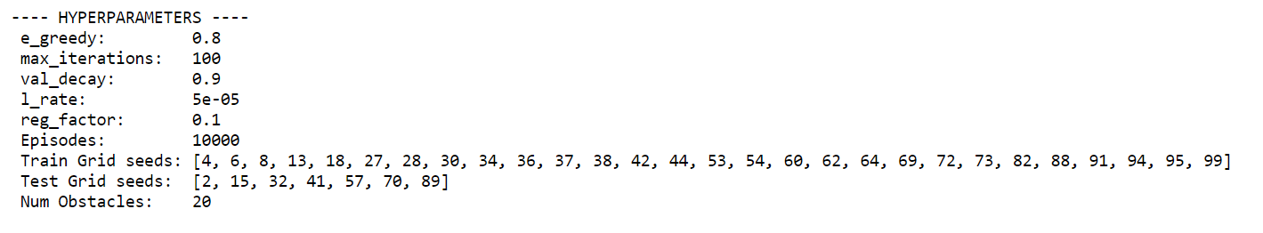
Hyperparameter

